Slide 1
Information Retrieval

Slide 2
Information Seeking
Information seeking is the process or activity of attempting to obtain information in both human and technological contexts. Information seeking is related to, but different from, information retrieval (IR).

Slide 3
Information Searching
A process, which people undertake to locate or retrieve specific information to meet an information need, typically, but not always with the aid of a search engine or other information retrieval system

Slide 4
Information Retrieval
Information retrieval (IR) is the activity of obtaining information system resources that are relevant to an information need from a collection of those resources. Searches can be based on full-text or other content-based indexing. Information retrieval is the science of searching for information in a document, searching for documents themselves, and also searching for the metadata that describes data, and for databases of texts, images or sounds.
Information Retrieval (IR) is finding material (usually documents) of an unstructured nature (usually text) that satisfies an information need from within large collections (usually stored on computers).
These days we frequently think first of web search, but there are many other cases:
E-mail search
Searching your laptop
Corporate knowledge bases
Legal information retrieval

Slide 5
Information behavior
Wilson's Nested Model of Conceptual Areas
The concepts of information seeking, information retrieval, and information behaviour are objects of investigation of information science. Within this scientific discipline a variety of studies has been undertaken analyzing the interaction of an individual with information sources in case of a specific information need, task, and context. The research models developed in these studies vary in their level of scope. Wilson (1999) therefore developed a nested model of conceptual areas, which visualizes the interrelation of the here mentioned central concepts.
Wilson defines models of information behavior to be "statements, often in the form of diagrams, that attempt to describe an information-seeking activity, the causes and consequences of that activity, or the relationships among stages in information-seeking behaviour" (1999: 250).

Slide 6
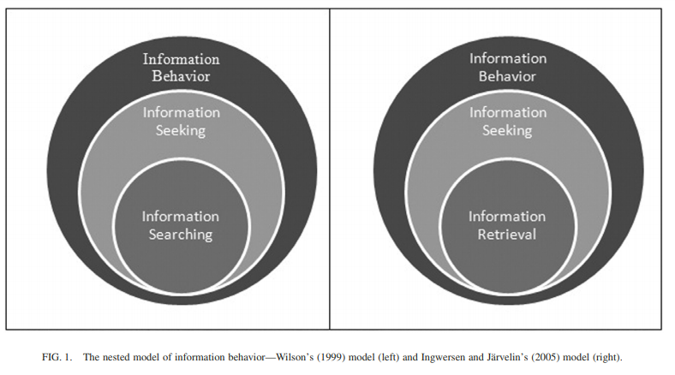
Model of Information Behavior

Slide 7
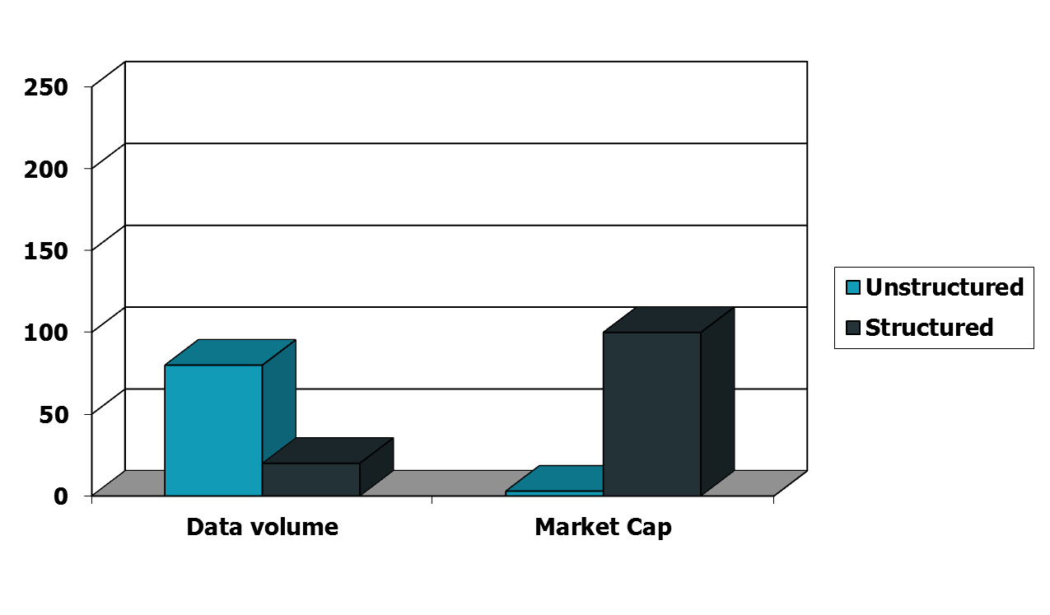
Unstructured (text) vs. structured (database) data in the mid-nineties

Slide 8
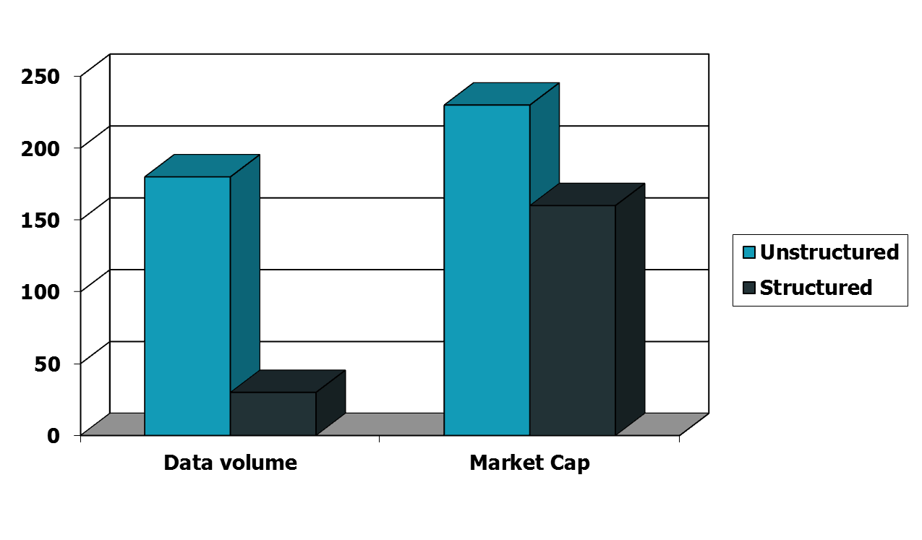
Unstructured (text) vs. structured (database) data today
Notes:
To the surprise of many, the search box has become the preferred method of information access.
Customers ask: Why can’t I search my database in the same way?

Slide 9
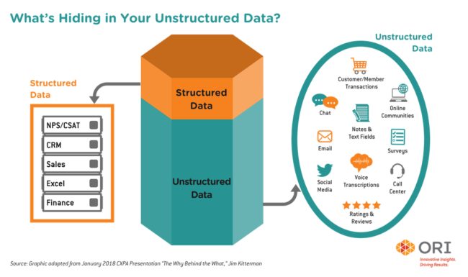

Slide 10
Basic assumptions of Information Retrieval
Sec. 1.1
Collection: A set of documents
Assume it is a static collection for the moment
Goal: Retrieve documents with information that is relevant to the user’s information need and helps the user complete a task

Slide 11
The classic search model
User task
Get rid of mice in a politically correct way
Misconception?
Info need
Info about removing mice
without killing them
Misformulation?
Query
how trap mice alive
Search
Search
engine
Query refinement
Results
Collection

Slide 12
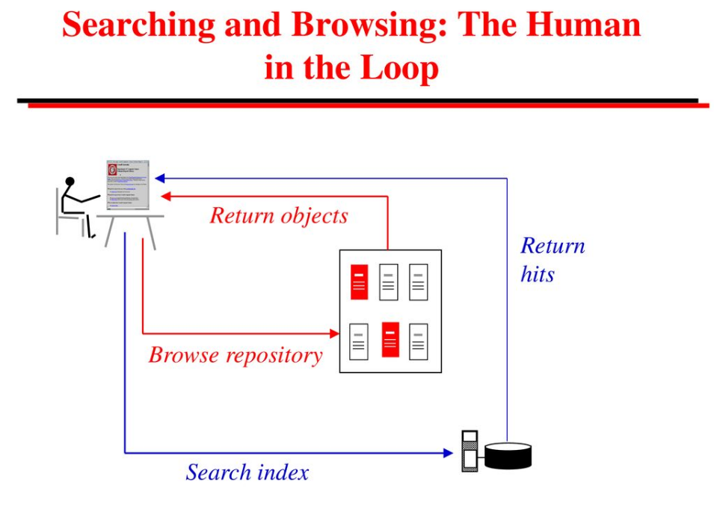

Slide 13
How good are the retrieved docs?
Sec. 1.1
Precision : Fraction of retrieved docs that are relevant to the user’s information need
Recall : Fraction of relevant docs in collection that are retrieved(berapa banyak dokumen yang dapat disajikan)
More precise definitions and measurements to follow later

Slide 14
The outline before Midterm
Search tools
Search Engines vs. Subject Directory
Meta search Engines
Steps for Searching
Effective Strategies
Boolean Logic
Narrow or broaden a search?
Wildcards

